Slide 1


Slide 3




-Outline-
Preface
Introduction of RUPP and OPU
About RUPP
Introduction of RUPP members
About OPU
Introduction of OPU members
Activities
Before going
During staying in Japan
After Returning
Back to Cambodia
Our Message
Acknowledgement
Message to Junior
Afterword

Slide 5
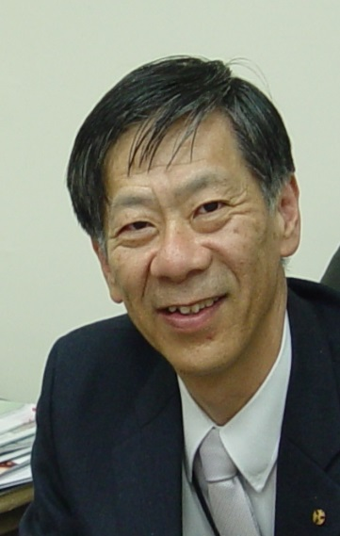
-Preface-
It is a great pleasure to know the activity on memorizing our Sakura-science project. This project aims young persons to be transnational persons (Sometimes such person is called global human resource or global talent). What is a transnational person? The foreign language skills are not enough to be a such person. Visiting experience on foreign countries are not enough, either. A transnational person should have global perspective, knowledge of many cultures, cross-cultural communication skills. He/she also should have ability to adapt to life in many cultural contexts and to work with and learn from cultural diversity. I hope everybody who joined in this project shall have ability to promote multiculturalism and respect for individuals from other cultures as equals.
Hiroshi TSUJI
Vice President
Osaka Prefecture University

Slide 7
Introduction of RUPP and OPU

Slide 8

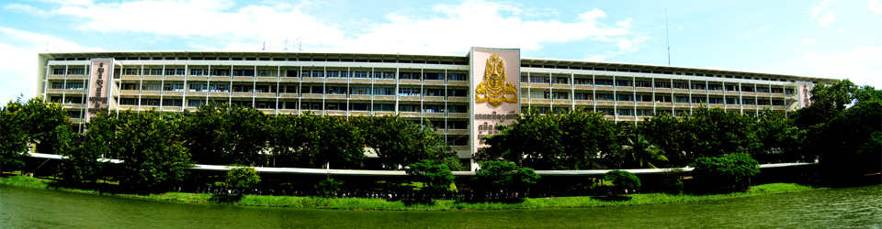
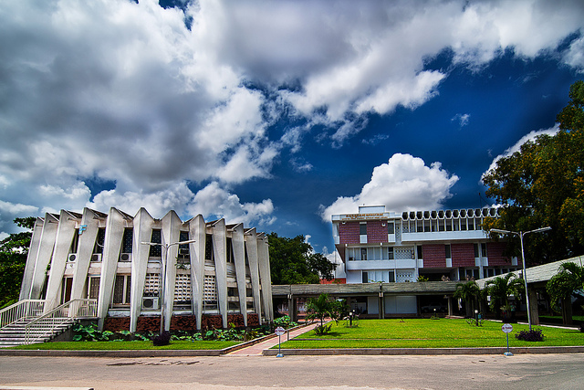
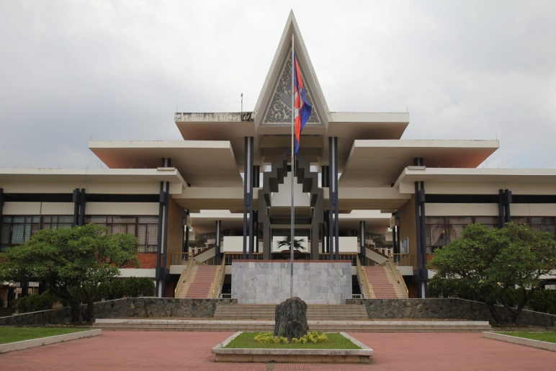
-About RUPP-
National university of Cambodia, Royal University of Phnom Penh is the oldest and one of the largest public universities. RUPP hosts more than 12,000 students across a range of undergraduate and postgraduate programs in such fields as sciences, humanities, and social sciences as well as professional degrees including information technology, electronics, psychology, social work, and tourism. In addition, it also offers degree-level language programs through the Institute of Foreign Languages.
The main campus lies roughly five kilometers from the center of Phnom Penh. Adjoining the main campus is the Institute of Foreign Languages—beautiful landscaping, amazing architecture, and conducive learning environment.
Roughly one kilometer further from town lies RUPP Campus II, in which the departments of History, Sociology and Philosophy reside—peaceful and high quality education center.

Slide 9
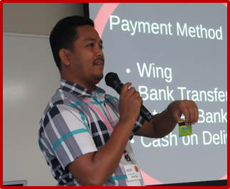
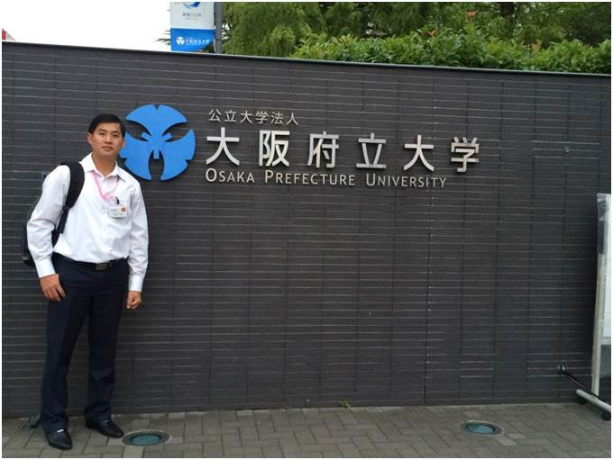
-Introduction-
-Members of RUPP-
Call me TAK. I am very happy to be a part in this Booklet. I am flexible, creative, patient, persistent, sincere, honest and I have sense of humor. I like reading, learning the differences such as people and technologies on our charming planet. I love researching, traveling, making friends and playing table tennis. I also love nature, sea, mountain, metropolitan, or nightlife. I enjoy all indoor and outdoor activities.
Tak KEAN
Ngorn Moi
Hello! I am Moi. I was happy to visit OPU last year. I got more experiences during my mission in OSAKA. I like working in group. My favorite sports are table tennis and swimming. Nice to knowing you all!

Slide 10
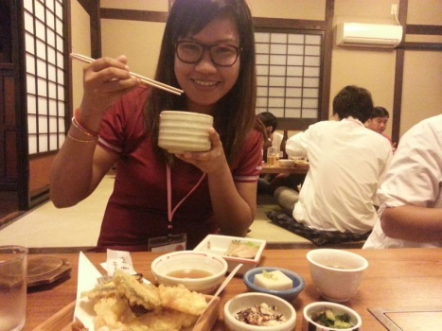
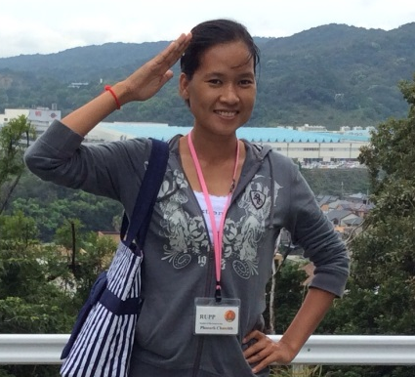
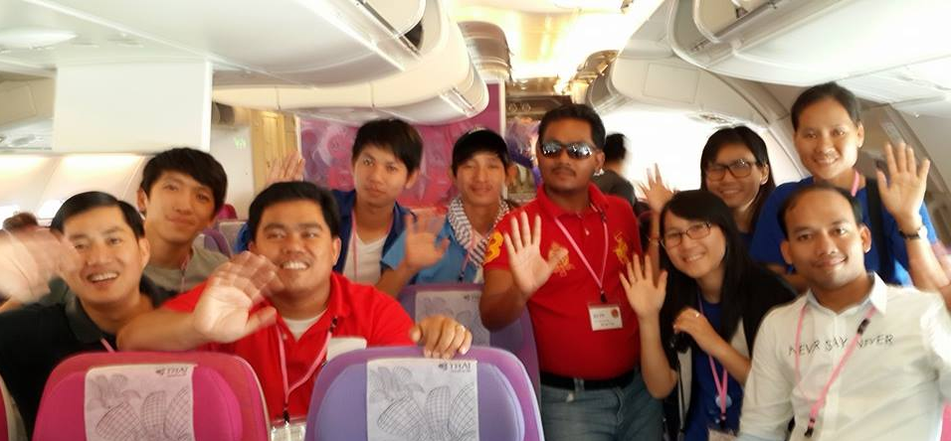
-Introduction-
-Members of RUPP-
Rim Beanbonyka
Just call me BONYKA.
Besides, cooking and eating, I love travelling and staying with nature.
My favorite sport is tennis. I play it at weekend.
I love Japan ^_^
Chanrith Phoeurk
Hello everyone!!!
You can call me “Chanrith”. I do like eating, travelling and listening to music. I love working both as a teacher and a researcher. I hope I can visit Japan again one day.

Slide 11
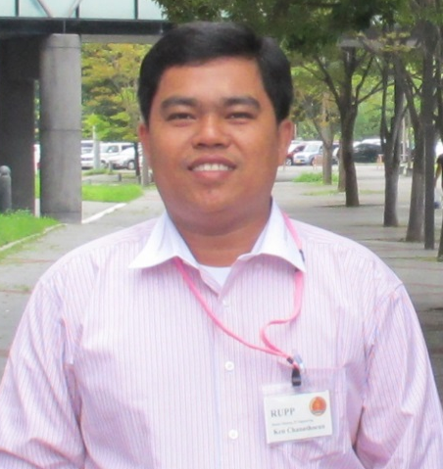
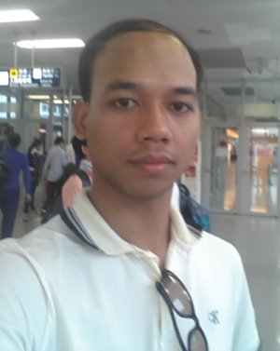
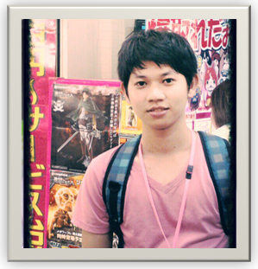
-Introduction-
-Members of RUPP-
Hi, I’m KEN Channthoeun, master of IT engineering student at RUPP. I’m an easy and learn fast person. I like programming, watching football, traveling with friends and especially family. In the future, I will build something that can make life easier. Japanese business or research partner would be best for me.
KEN Channthoeun
Hi Everyone! I am NETH Sovathena, a master student of IT Engineering from RUPP. My favorite subjects are Machine learning and Image Processing. I love researching, coding, and learning new technologies. After work and study, I like playing volleyball or table tennis. More than that, I like going around with family and/or friends on holiday.
NETH Sovathena
Hi, I am Sakey SALY. I am an easy person and like something simple. I love programming and interested in AI and Game development, so no doubt that I am a gamer. Beside game, I like soccer and my favorite team is Barcelona.
My wish is to create a game development team and travel the world.
SALY Sakey

Slide 12
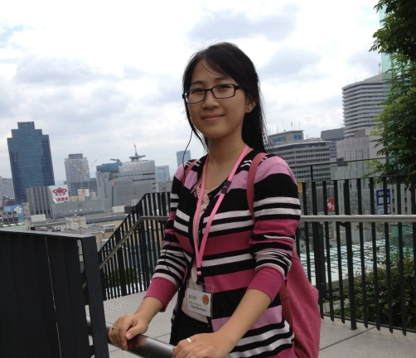
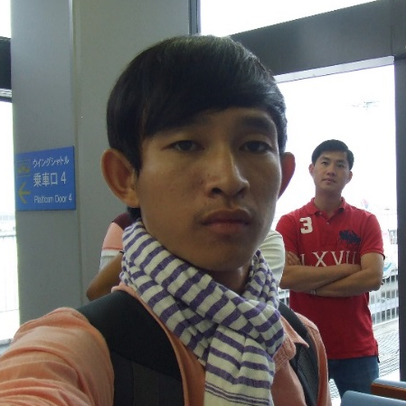
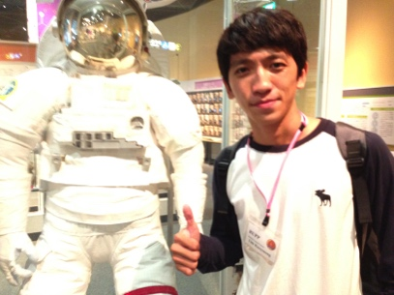
-Introduction-
-Members of RUPP-
Hi there! This is Rachana. You can actually call me Ra-Cha-Na. I think I smile a lot every day because I believe things could be better with just a smile. I would define myself as a technology girl as I simply love the innovation and invention of the technology things. My dream is to make everyone dare to have and enjoy their dreams. ☺
NGET Rachana
Smile??? ☺
SENG Sovanminea
Hi! My name is Seng Sovanminea. To make it easier, just call me MINEA. I like listening to music every time. Besides my utmost moment in studying, I also like playing football. In the future, I want to become a businessman. Lastly, I hope I will go to Japan again.
Say Cheeeeese!!!
Lim Kuoy Suong
Hi, I’m Suong. I love designing and inventing. Soccer and swimming are my favorite sports. My dreams are to create something that people can’t live without and to travel the world with my beautiful wife.

Slide 14

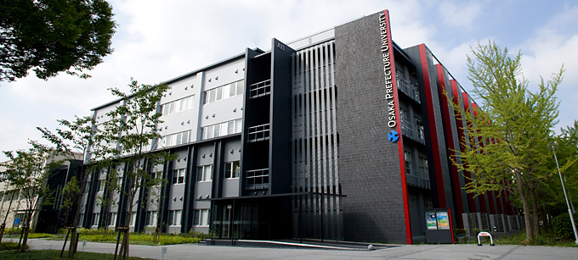
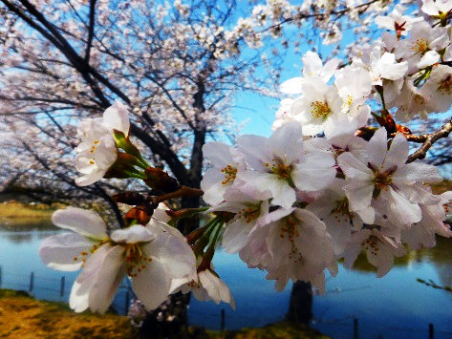
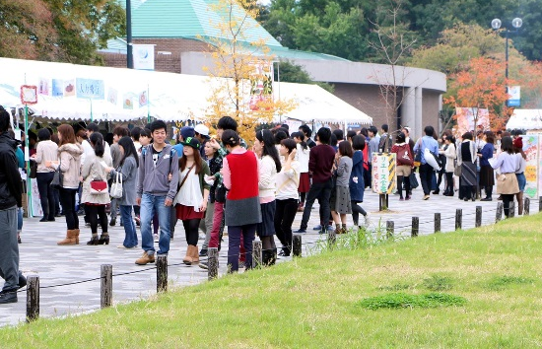
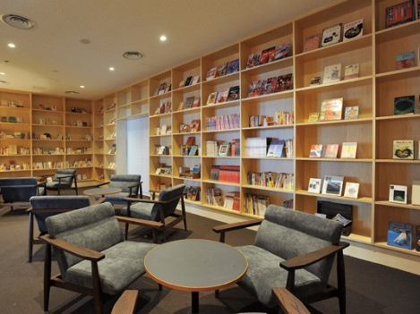
-About OPU-
OPU is located in the heart of Japan, in Osaka of the Kansai area, where its history has shown that the tradition of creative and innovative ideas has long existed. Our university has carried on this tradition - in 2005, three universities, Osaka Prefecture University, Osaka Women's University and Osaka Prefectural College of Nursing, have been merged as one great engine for Osaka.
OPU has one of the largest campus areas in Japan, and it has a very nice relaxing atmosphere especially in the parks where children often come to play during holidays.
With around 8,000 students and 900 faculty and staff members, our campuses make an ideal academic setting for new students to gain essential knowledge while exploring new frontiers. We partner with 134 universities and 9 institutes in 37 countries and one region for academic and research cooperation. This provides OPU faculty and students with more chances and opportunities to learn with and through international colleagues and students.

Slide 15
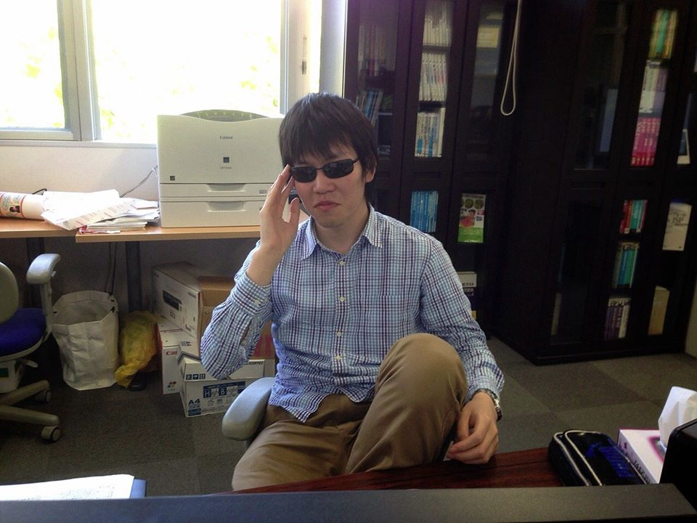
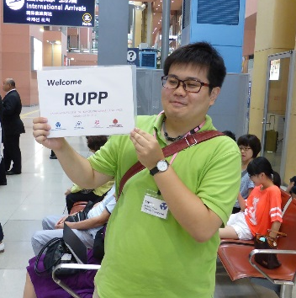
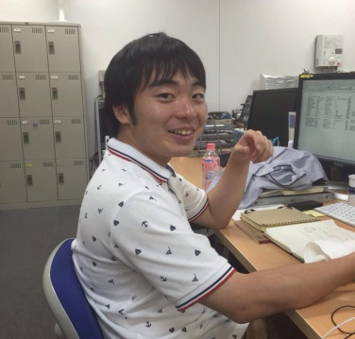
-Introduction-
-Members of OPU-
Yoshihisa Itsukashi
Hello, I’m Yoshihisa. Seeing Cambodian friends made me feel that speaking English was very important. So, I’m making effort to study English. I want to communicate with foreigners in English!
I always smile!!!
Hi! I’m Hiroki! Call me Hiro or Hiroki! I like cooking, drinking, driving and so on. I am making a system to support teachers working in special support education schools.
Thanks to Cambodian Friends, I can change myself. I will go Cambodia:-)
Hiroki Taniguchi
I love Cambodian friends :-D
Ryosuke Nagai
Hi , Everyone! Please call me Ryo! I have never been abroad. So, I want to visit many foreign countries in the future. The world has many things which I don’t know!!

Slide 16
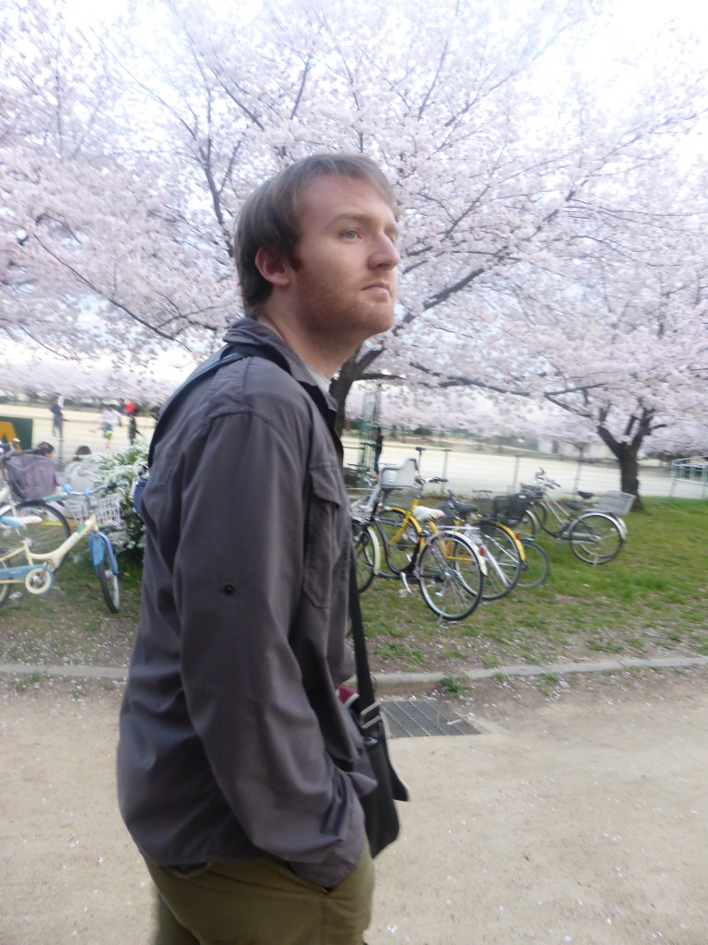
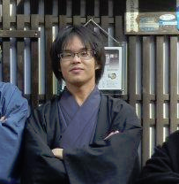
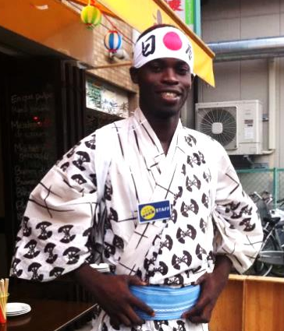
-Introduction-
-Members of OPU-
Corentin Jouault
Hello ! Please call me John ! It is a pleasure to get to know people from Cambodia. I like to learn about other countries' culture.
Kazuki Kishimoto
I like meeting and talking with someone. So this program was delightful for me. I’ll start working in April 2015, so by then, I plan to travel to Cambodia. Now, I start studying English again by listening to presentations in English.
I’m Japanese Samurai
Emmanuel Ayedoun
Hi, I’m Emmanuel AYEDOUN, international student at OPU. I’m an open person, that’s maybe why I've got so many friends from all over the world. Whatever happen, i always do my best to keep calm and be positive. Besides watching soccer(I'm a fan of Real Madrid CF), camping or just hanging out with friends, I do love taking care of my cute tropical fishes.

Slide 17
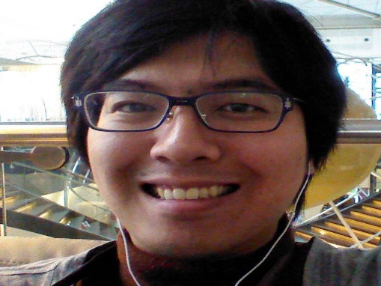
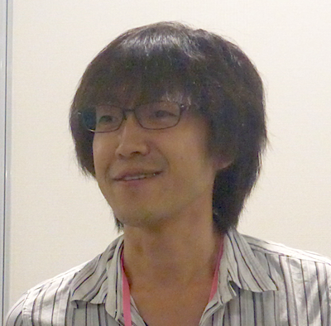
-Introduction-
-Members of OPU-
Hi, I’m Ryosuke Saga, Associate Professor in OPU. I am interested in Data Engineering and Information Systems. RUPP’s friends and I have been together for four years so that I’m very happy to join this friendship program. With this Sakura Science Plan, I hope that the relationships between RUPP and OPU progress towards best friends in Asia :)
Ryosuke Saga
Hi, I’m Yuki HAYASHI, an assistant professor at OPU. My research interests include the area of human-computer interaction. Especially I am interested in analyzing multimodal interaction in multiparty conversation. Please remember the days you have spent with us in Japan. Happy trails to you until we meet again!
Yuki Hayashi

Slide 18
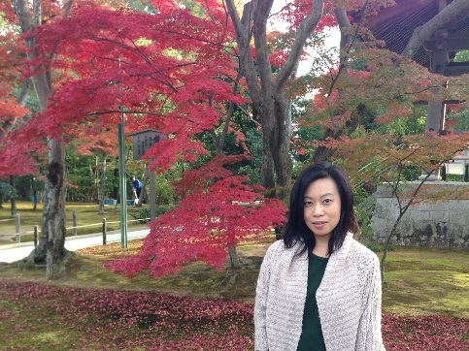
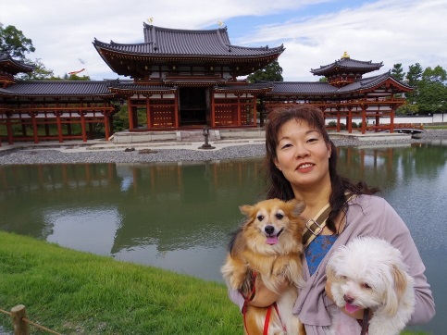
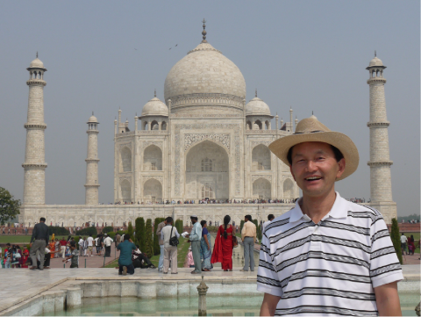
-Introduction-
-Members of OPU-
Miho Yoshihara
It was a great pleasure that I could join Sakura RUPP-OPU project, hope I could be of some help! I was very much impressed everyone was keen to learn about each other. Thanks for this program, I enjoyed the cultural exchange and also learned a lot. Traveling to Cambodia became my next target!
Rie Wakagi
I was glad that I could be concerned with RUPP members and OPU members through this program. I wanted to go to Osaka Science Museum, DAISO and others with all of you. Has your impression of Japan and Japanese changed after participating in this program? I met RUPP members and now want to go to Cambodia.
Mike Kitadeya
Hi, I am Mike Kitadeya, a staff member of the SiMS Program Office.
I like travelling different countries to see different culture. I visited many World Heritages sites around the world, and I would like to see the Angkor Wat in the future.

Slide 19
Activities

Slide 21

-Before going-
-Homework-
★Learn from each other!!
To exchange the knowledge and share experience between SiMS students and RUPP students, we proposed a topic of “e-commerce”.
-Skype Conversation-
★Well prepared!!
Some students never go out of Cambodia. Therefore, the skype conversation between OPU and RUPP is set such as a discussion on pick-up service, umbrella, and more.
-Packing-
★We are excited what should be packed!! Don’t over-pack!

Slide 22

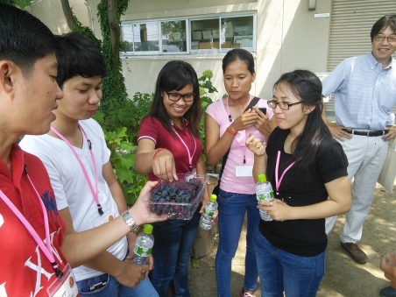



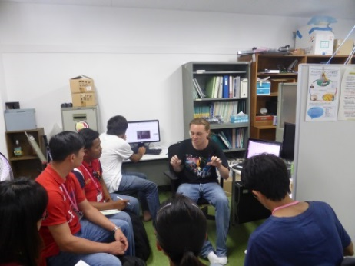
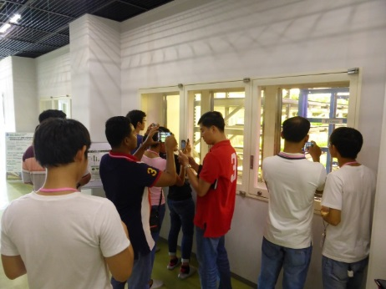
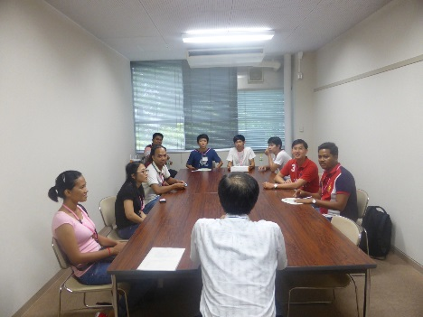

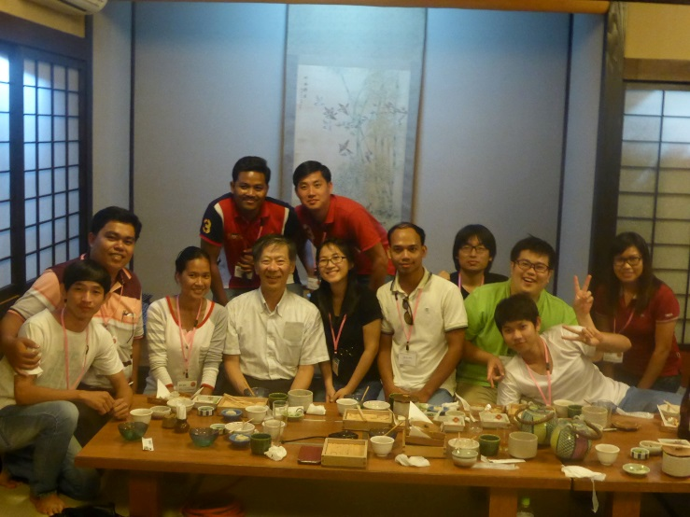
-DAY 1-
-Welcome to OPU!-
Yoshihisa Itsukashi
Hiroki Taniguchi
It was our first meeting.
Cambodians came to Japan in early morning! Hiroki and
John picked up them at Kansai airport and took them to
OPU.
We visited some facilities in OPU and became friends.
After their arriving , we visited plant factory and OPU Farm. At OPU Farm, we had some fruits harvested there, and at lunch, we ate sandwich including fresh vegetables made in plant factory. It was good experiences for us.
In the afternoon, we visited some laboratory in OPU. Some systems were suggested and we tried to understand.
In the end of Day 1, we attended a banquet with Prof. Tsuji. Through this banquet, we could form close relationship. In Japan, there is a proverb to intend like this.
“Onaji kama no meshi wo kuu”
“同じ釜の飯を食う”
Thank you, friendly Cambodians and Prof.Tsuji. It was really precious time.

Slide 23
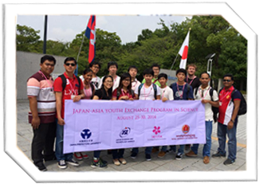
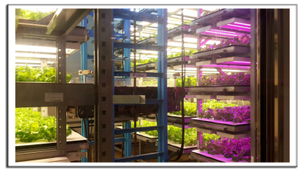
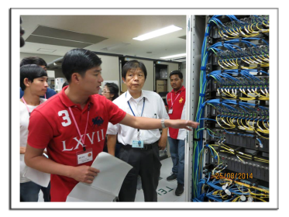

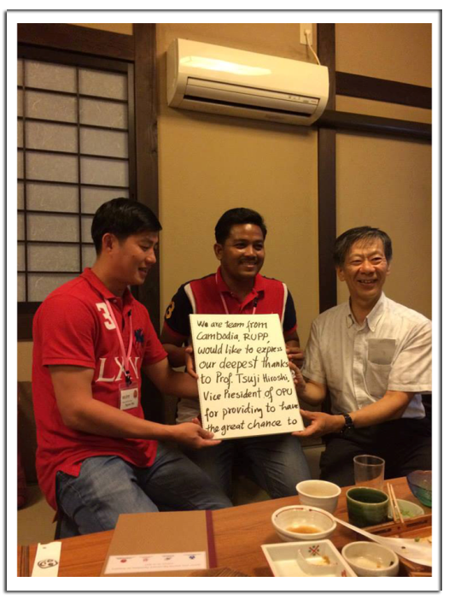


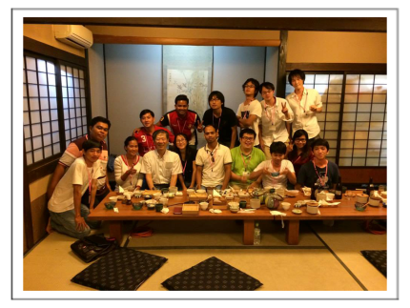
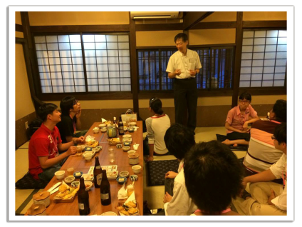
-DAY 1-
-The Journey Began-
Saly Sakey
Every one of us were in their first time visited Japan. You will understand our feeling. Impression, exited, happy and joys are full in our hearts and souls. Here we arrived OPU and the journey begins…
After a long trip from Cambodia, finally we arrived Osaka Prefecture University. We have a very great welcome from Japanese students and professors.
Professor Seta’s team guided us to visit many professors and laboratories. We were so impressed with their researches and technology of Japan.
One day seemed so short. Everyone had a bit tired, but they keep smiling because of the joys they have. We finished the day by a great meal in a traditional Japanese restaurant with Professor Tsuji, the vice president of OPU . Thank you, for your warm welcome, OPU members.

Slide 24
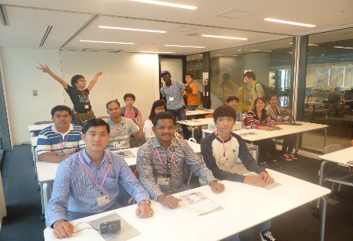
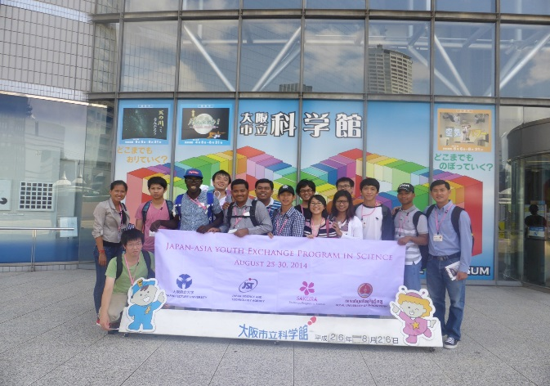
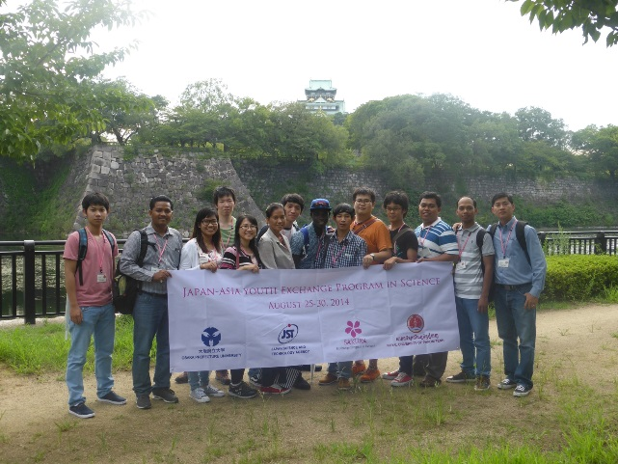

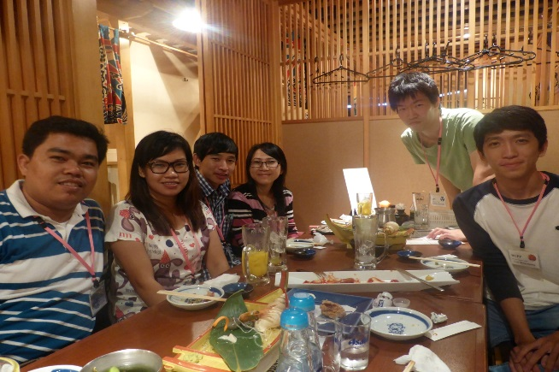
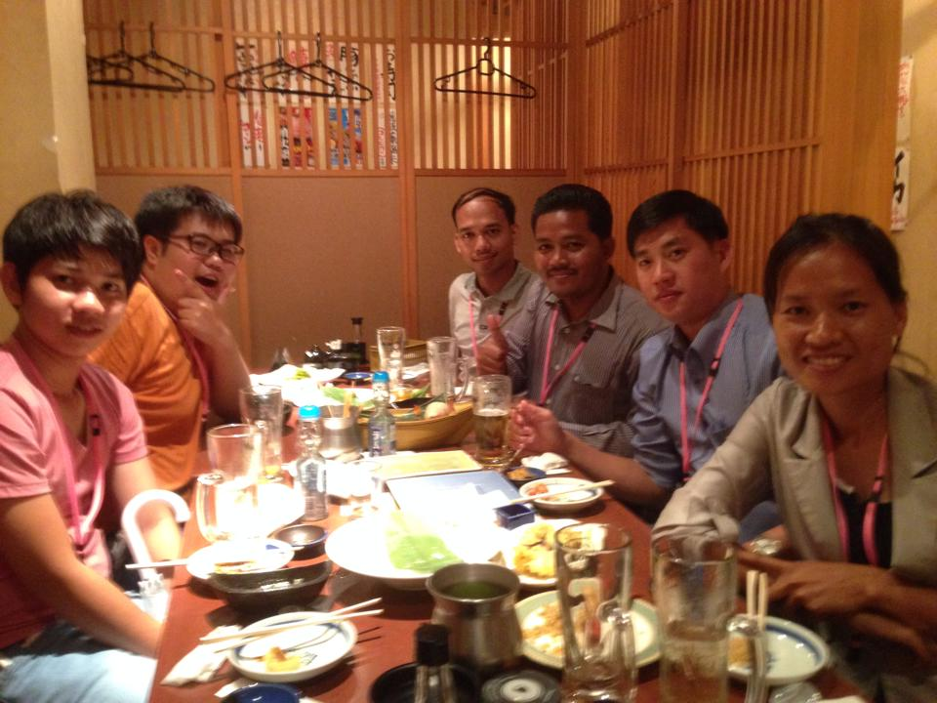
-DAY 2-
-Osaka sightseeing-
Ryosuke Nagai
The 2nd day, Students of Seta Lab and Emmanuel guided
our friends in Osaka.
First, we went to Knowledge Capital @ Grand Front
Osaka. Staff explained Knowledge Capital and guided
us through many facilities. RUPP members heard
with good interest and asked them many questions.
Next , we visited Osaka Science Museum, and saw the planetarium as well as various science technology.
Last , we took the Aqua-Liner to Osaka Castle Park. We admired the charms of Osaka from the river side. We weren’t able to visit the Castle itself, but we took many photos having it in backside.
After finising sightseeing , we went to seafood restaurant. We had a very busy day moving from one place to another and everybody was tired, but we forgot fatigue during a meal and had many talks with each other. It was a wonderful day, we knew each other well than 1st day!!

Slide 25
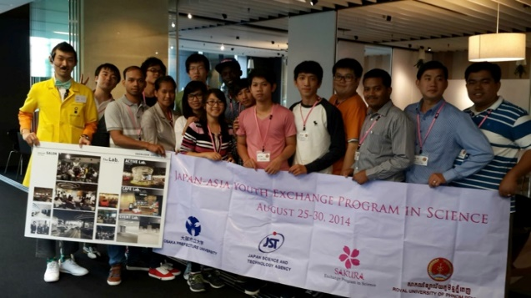
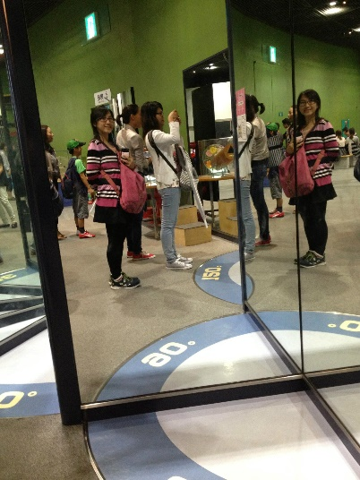
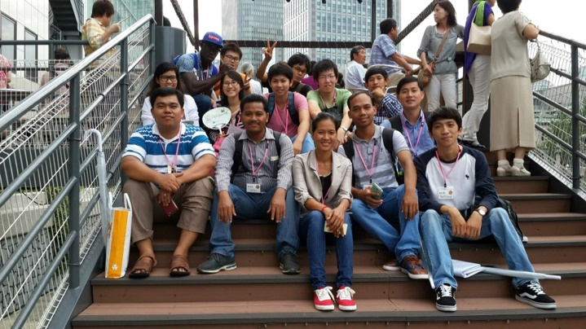

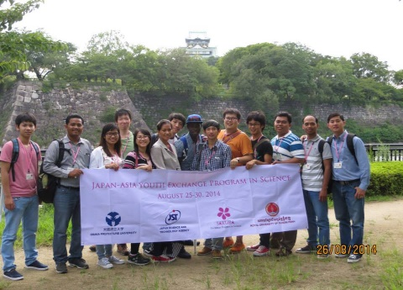




-DAY 2-
-Visiting Knowledge Capital
And Osaka Science Museum-
Rim Beanbonyka
This lab is so amazing. It is not only a place to exhibit, but also to promote new values and innovation. With 3 types of Lab (Active lab, Café lab, and Event Lab), we can see the new prototypes of cutting-edge technologies, products and services.
It is the place that I love the most. It is the place for fun, learning, exploring, and interacting with science. Besides, reading and studying the phenomenon of physics, chemistry, geology, … from textbooks and try to remember all of them by heart; we just go to the Museum then we can learn all those things, even kids can learn them in entertainment way.

Slide 26





-DAY 3-
-System inspired thinking-
Emmanuel AYEDOUN
Observing Cambodian and Japanese young people gather, think and discuss together about each other country issues made me feel proud, happy and furthermore incredibly lucky. I’m pretty sure that the key to build a better world is to give young people, who are the future of their countries, the opportunity to think, exchange, share values and learn from each other. One thousand thanks to SIMS professors and staff for making this possible.
After the workshop, we made a surprise to Rachana for her birthday, a perfect end to a memorable day.

Slide 27






-DAY 3-
-Presentation? Birthday Celebration?-
NGET Rachana
On the third day of Sakura Exchange Program at OPU, there were an interesting session about the SiMS program and a discussion regarding E-Commerce status of Cambodia and Japan. Surprisingly, everyone celebrated my birthday.
In the morning, a professor from OPU presented the SiMS program to RUPP students and lecturers, and current SiMS scholarship recipients. It was very informative and interesting.
In the afternoon, there was a fascinating discussion between Cambodian and Japanese students about the E-Commerce of both countries. We learned a lot from one another, and we have brought back all those ideas to our home country for the future implementation of E-Commerce.
After all the discussion, there was a dinner reception which was honorably attended by OPU president, vice president, professors, Japanese students, and all RUPP students and lecturers. Unexpectedly, everyone sang me a happy birthday song during the reception. Then, there was another birthday celebration at the Spanish bar. It was an amazing moment when my Japanese friends arranged the surprising birthday celebration for me. I am really thankful for all the arrangement, especially Emmanuel who bought me a very nice cake. That was one of the best moments in my life to celebrate my birthday abroad.

Slide 28




-DAY 4-
-Let’s Go To WAKAYAMA-
Yoshihisa Itsukashi
This day, our friends went to Wakayama with Prof. Seta, Yoshihisa, Hiroki and Emmanuel.
Not only Cambodians but also Japanese had extraordinary experiences and be excited.
In the morning, we went to Wakayama university. Prof. Matsuda presented two research announces. Our friends were positive to ask some questions and to discuss.
In the afternoon, we went to ironworks of NIPPON STEEL & SUMITOMO METAL CORPORATION. It was very large factory! And In the factory, some machines were so big and hot that we couldn’t help to be excited or scream! Some wished it had been OK to take photos…
In the evening, we came back to OPU and held party near OPU.
We presented Japanese traditional items, Sensu to Cambodians. And Cambodians presented Cambodian key chains to us!
It was so happy time for both Cambodians and Japanese.

Slide 29





-DAY 4-
-An amazing Day at the Wonderful Place, WAKAYAMA-
Chanrith Phoeurk
On the third day of Sakura Exchange Program, we did enjoy in every section we participated. We had never imagined how wonderful of natural views and designs they are in Wakayama. We always keep ourselves awake in looking to Japanese living style, natural views, and technology, etc.
In the morning, Prof. Seta and our Japanese friends came to pick us up to Wakayama University. Along the way to there, we always keep our eyes open to see how amazing life style and technology they are. We were also interested in all research topics presented by professors and students at Wakayama University.
In the afternoon, we went to Nippon Steel & Sumitomo Metal, we was very exciting for the chance to visit one of the best steelmaker in the world. We were so lucky to know and see the main process of iron making, steel making, and till the final products. It is like a miraculous work that they can keep factory process all the time.
In the evening, we came back to OPU and held a party nearby there. Wow!!! We did really enjoy in moments of sharing our feeling, experiences, and souvenirs with Japanese people, and we do love Japanese food a lot. We wish we will be there again someday….^_^

Slide 30






-DAY 5-
-Workshop and Smile-
Hiroki Taniguchi
We went to I-site Namba: OPU campus in Namba, we hold a workshop for mutual understanding between Cambodia and Japan. It was really precious time for us to understand Cambodian friends and ourselves.
We made a presentation with using white wall and pens. It was very fun.
And we Japanese learn one thing from Cambodian friends.
“More smile, more happy:-D”

Slide 31






-DAY 5-
-Shopping Vs Research Exchange-
Lim Kuoy Suong
We love shopping. Today, we got to shop at Daiso and Yamaka-Denki in the morning. In the afternoon, the research presentation, the collaborative work, and cross cultural workshop were incredible.
Shopping in Japan is a little expensive for us, but Daiso allows us to buy a lot of good quality stuffs to bring back to Cambodia. I was amazed by the huge size of Yamaka-Denki store.
In the afternoon, we had the chance to listen to research findings presented by professors of OPU. The workshop that followed was amazing as we worked together to find factors and solutions to promote unity and mutual understanding.

Slide 32





-DAY 6-
-The best is yet to come-
Kazuki Kishimoto
The time which is delight and fulfilling just flies by.
Finally, the day which our friends go back to Cambodia
has come.
Kazuki and Hiroki go to an Kansai airport
to see our friends off and say "good bye".
In morning, we picked RUPP members up at the hotel, and go to Kansai airport with them. At that time, we didn't use the local train, but use the express, named "Rapit".
In fact, Kazuki and Hiroki felt upset because we are going to be late for the departure time of train.
We arrived the airport, RUPP members finished check-in. So, the time has come.
We took pictures, shake hands and sent our friends departure.
You said "Please come to Cambodia sometime".
Of course!! We promise!! At that time, we 'll communicate with you, please meet again!!

Slide 33







-DAY 6-
-Friendship worth remembering-
SENG Sovanminea
After all the activities were undertaken, here come the end of the program.
Even though time is short, yet we made lots of memories and experiences
In the morning, we walk directly to nearby train station right after check out from the hotel. Unlike usual, we took an express train to Kansai airport.
Trying to find terminal of our flight was our first thing to do when we get to the airport.
Finally, we sincerely say good bye to our Japanese friends and had great photos before taking off. It was time to say the trip is at the end but our memory and friendship last.

Slide 34
-After Returning
Back to Cambodia-
-The things I learned
through Sakura Science Project-
Culture
I felt it was important to think there are a lot of culture in the world. Cambodian friends could know Japanese culture. I also could know a little Cambodian culture. To know more about Cambodian culture, it needs to go to Cambodia. I should go Cambodia, where I want to feel their culture☺
Communication by using English
It was a first time for me to talk with the people couldn’t speak Japanese. The first day I can’t say anything. As the days passed, I became to want to talk with. Thanks to them. I could become to speak English.
From: Hiroki Taniguchi

Slide 35
-After Returning
Back to Cambodia-
-Souvenir-
Shopping in Rush Hour
- It was great to have 10 min-boarding time delay. We rush to seek for many souvenirs for family, friends, and co-workers. Wow!!!! We could get every lovely thing we need like Japanese chocolate/biscuits, watches, key holders, etc.
-Safe Journey-
Our flight and landing were safe and sound. We could reach our destination on time without any problem. Our families were waiting to see and pick up us happily. Finally, we did enjoy sharing our souvenirs with families!!!!!
From: Chanrith Phoeurk

Slide 37
Our Message

Slide 38
-Acknowledgement-
Representing a group of Sakura Exchange Students from Royal University of Phnom Penh, we would like to express our sincere appreciation to all people who provided us the possibility and kind assistance to make this project happen. A special gratitude is given to Prof. Hiroshi Tsuji, whose contribution made this Sakura Exchange Program an amazing project for our group.
Furthermore, we would like to express our deepest gratitude to the following professors, project assistant, Japanese and international students at OPU, who arranged the whole program and gave us a very warm hospitality.
Prof. Taketoshi OKUNO - OPU President
Prof. Hiroshi TSUJI– Project Proposer
Prof. Kazuhisa SETA– Project Organizer
Prof. Ryosuke SAGA– Project Collaborator
Prof. Yuki HAYASHI – Project Organizer (assistant)
Professors from SiMS program – Workshop organizer
Ms. Miho YOSHIHARA– Project Assistant
Students – Participant
Last but not least, we would also like to acknowledge with much appreciation to the crucial role of the staff of Osaka Prefecture University, who warmly welcomed and provided us such good experiences in Japan.
Most importantly, we are so grateful for all the advices and guidance from our university rector, project proposer, and project organizers, who provided us the golden opportunity to attend and learn from Sakura Exchange Program.
H.E Dr. Cheat Chealy – RUPP rector
Mr. Phal DES – Project Proposer
Dr. Kong Marry – Project Organizer
Mr. Khoy Saovorak – Project Organizer (assistant)

Slide 39
-Message to juniors-
-From OPU student-
★Please don’t be shy!!
I think the Japanese tend to be shy like me. And for Cambodian, it seems that you have a lot of worry about Japan because it isn't known well.
However, both Japanese and Cambodian are very kind, so please be honestly and talk a lot. I noticed during this project that if I manage to communicate, I can communicate with Cambodian friend. So, please don't be shy, talk a lot!
From： Kazuki Kishimoto
-From RUPP student-
Hi Juniors!
It is my honor to have a chance to share my impression toward the Sakura Exchange Program. First word I would say is “AWESOME”. I am so impressed of how much I have learnt during this program. I think I am so fortunate to be one among the prticipants. SMILE ☺
From: NGET Rachana

Slide 40

-Schedule-

Slide 41

-Afterword-
This Sakura-science program was one of the most impressive, valuable and memorable events for us. I really appreciated your collaborative work to make this great booklet. I feel happy Kazuki and Hiroki will bring this booklet to your place. This is the symbol for our collaboration. I hope you keep in touch even after 20 years.
I was reminded of your friendliness, kindness, smile, taking photo:-) ... If I try to take the most impressive thing for me…, all of you asked meaningful good questions every time for everything in sight seeing, eating, visiting factories, laboratory tours, workshops… It is the most important skill for intellectual people in the 21st century wherever we are on the earth.
Needless to say, the skill of generating good research questions is really important to acquire fruitful research results. I believe all of you have a potential to become elite leaders and researchers to build a new generation of Cambodia.
How about getting Ph.D. in OPU?
Program Organizer
Osaka Prefecture University
College of Sustainable System Sciences
Kazuhisa SETA

Slide 42


